Slide 1

KOLHAPUR INSTITUTE OF
TECHNOLOGY(AUTONOMOUS),KOLHAPUR
◆
TOPIC : LAMP DIMMER

Slide 2
AUTOMATIC EMERGENCY LIGHT
◆
◆
SUBMITTED TO :-
Faculty of ANALOG CIRCUIT Prof Mr. Ajay Pol
CREATED BY :-
B[21] Aditya Kalwad
B[22] Shraddha kamat
B[25] Aishwarya Kate
◆
◆

Slide 3
We would like to thank our supervisor Mr. Ajay Pol Sir, for the valuable advice and support in selection of topic. We would like to Thank our group members for their contribution towards the project.

Slide 4
RELEVANCE
Dimmers can provide many benefits such as helping create ambiance by allowing you to adjust light levels, they reduce energy consumption which allows your bulbs to have a longer life, and they can help lower your electric bills.
With the wide variety of bulbs now available on the market, it is important to choose a dimmer wisely since not all dimmers are designed to control all types of bulbs.

Slide 5
Dimmers are used small unit size in domestic light switches to high power units used in large theatrical or architectural lighting installations. Dimmers being able to control the lighting system are empolyed in living room, kitchen, etc in home. Dimmers enhance flexibility of electric flow in electric lamps and chandliers.
PRESENT THEORIES & PRACTICES

Slide 6
BASIC CONCEPT OF PROJECT
Dimmers are devices connected to a light fixture and used to lower the brightness of light.
By changing the voltage waveform applied to the lamp, it is possible to lower the intensity of the light output.
the term dimmer is generally reserved for those intended to control light output from resistive incandescent, halogen, and (more recently) compact fluorescent lights(CFLs) and light-emitting diodes (LEDs).

Slide 7
BLOCK DIAGRAM

Slide 8
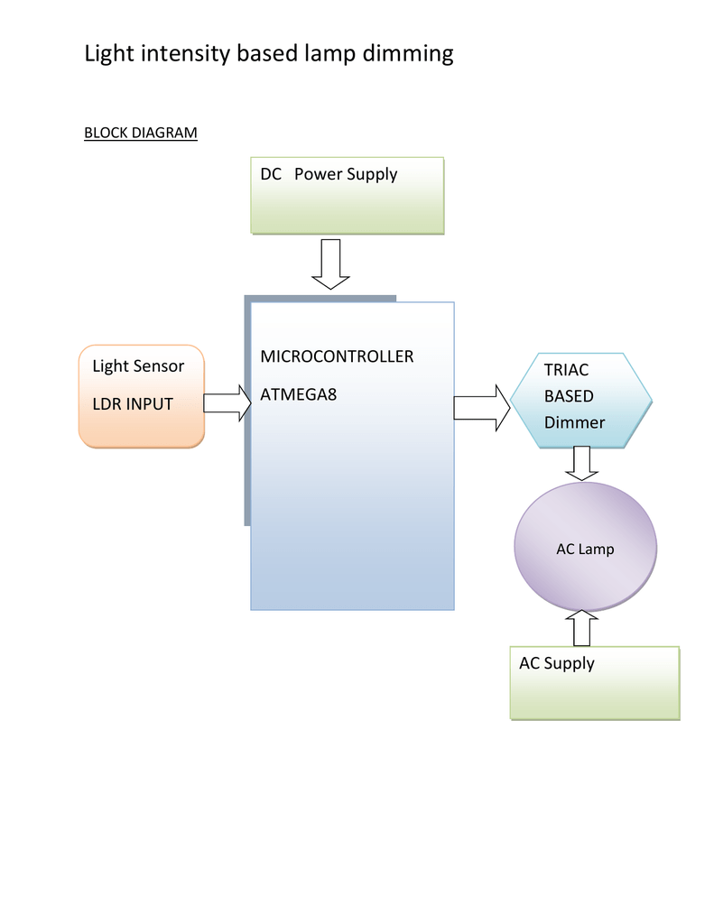

Slide 9
CIRCUIT COMPONENTS
IC LM358(IC1)-1
Transistor BC547 (T1) – 1
Resistors (R1, R2) 4.7KΩ – 2
Resistor (R3) 22KΩ – 1
Resistor (R4) 10KΩ – 1
Resistor (R5) 4.7MΩ – 1
Resistor (R6) 100Ω – 1
Capacitor (C1) 0.47µF – 1
LEDs – 3
9V Battery
Breadboard
Connecting Wire

Slide 10
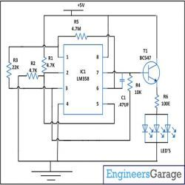
CIRCUIT DIAGRAM

Slide 11
LIST OF REFERENCES
https://www.electronicshub.org
https://www.circuitstoday.com
https://en.wikipedia.org

